Slide 1
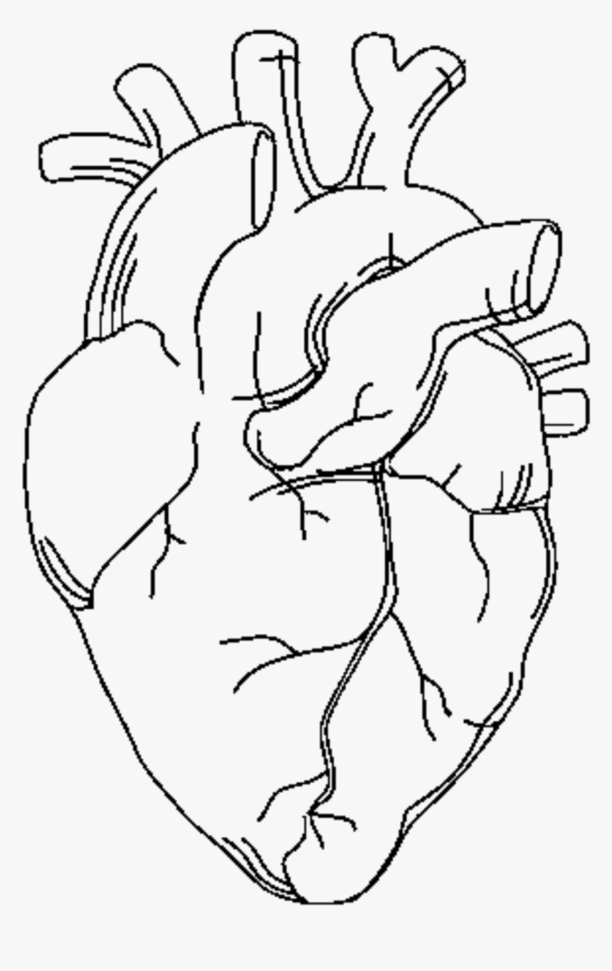
Heart Disease Prediction
Group 20
Zeinab Alazzawi
Hussain Alhassan

Slide 2

Problem Statement
How to predict who has an increased chance of developing a heart disease based on previous patients’ data.

Slide 3
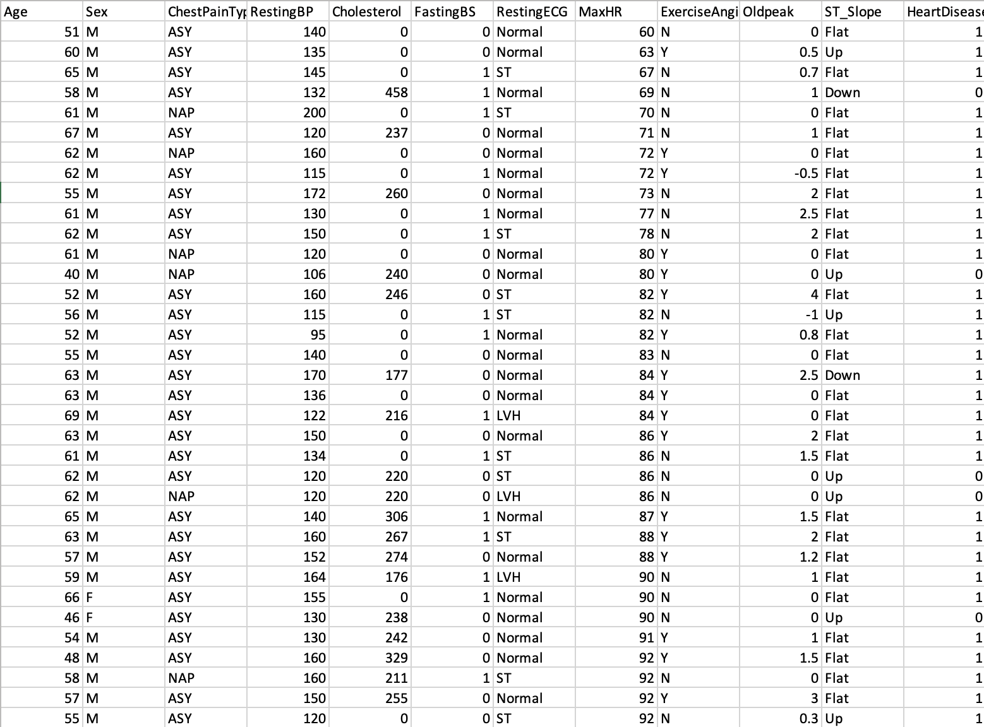
Data Sources
Heart Failure Prediction Dataset
https://www.kaggle.com/fedesoriano/heart-failure-prediction
918 rows of data and 13 columns
Primarily used Age, Sex, ChestPaintype,HeartDisesase.
Used google colab
https://colab.research.google.com/drive/1Mvin4iU3GHTOwlizLc5jdNyAaH9SDKXi#scrollTo=eLXl_hPkEMbJ

Slide 4

Purpose
Cardiovascular diseases takes 17.9 million lives each year, which accounts for 31% of all deaths worldwide.
Predict what demographic is more likely to develop heart disease based on their age, gender, and chest pain type.

Slide 5

Data Preparation
Cleaning:
Removed null values
Converted columns into numeric data.
Validating:
Linear Regression model to estimate how dependent variable changes in relationship to two others.

Slide 6

Data Preparation
Partitioning:
Splitting data into X and y variables.
Visualizing:
Scatterplots of the 3 columns.
Bar charts of the relationshps.

Slide 7

Modeling
Retrieve all data with HeartDisease = 1 (True)
01
Scatterplots to show relationship between each column
02
Partition data and linear regression model
03

Slide 8
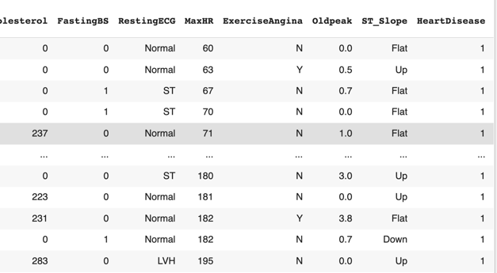
All data where HeartDisease = 1
Heart_Disease = heartdata[heartdata['HeartDisease']==1]
Heart_Disease

Slide 9
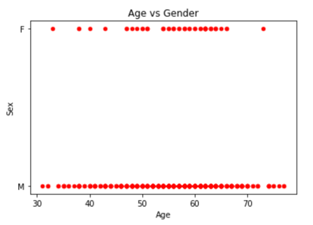
Scatterplot – Age vs Gender
Heart_Disease.plot(x='Age',y='Sex',kind = 'scatter', c='red')
plt.title('Age vs Gender')
plt.show()

Slide 10
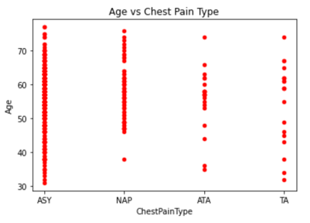
Scatterplot – Age vs Chest Pain Type
Heart_Disease.plot(x='ChestPainType',y='Age',kind = 'scatter', c='red')
plt.title('Age vs Chest Pain Type')
plt.show()

Slide 11
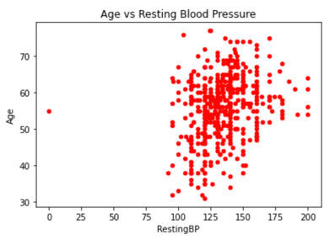
Scatterplot – Age vs Blood Pressure
Heart_Disease.plot(x='RestingBP',y='Age',kind = 'scatter', c='red')
plt.title('Age vs Resting Blood Pressure')
plt.show()

Slide 12
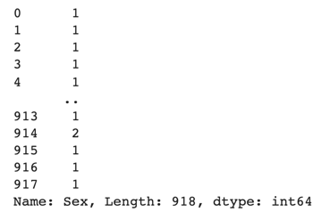
Replace String with numeric value
heartdata['Sex'].replace('M', 1 ,inplace=True)
heartdata['Sex'].replace('F', 2 ,inplace=True)
heartdata['Sex']

Slide 13
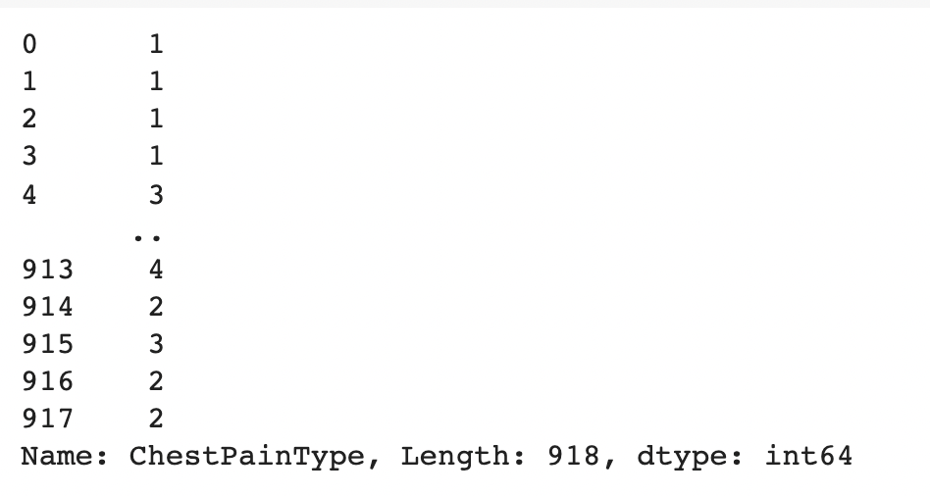
Replacing strings in ChestPainType into numeric values
heartdata['ChestPainType'].replace('ASY', 1 ,inplace=True)
heartdata['ChestPainType'].replace('ATA', 2 ,inplace=True)
heartdata['ChestPainType'].replace('NAP', 3 ,inplace=True)
heartdata['ChestPainType'].replace('TA', 4 ,inplace=True)
heartdata['ChestPainType']

Slide 14
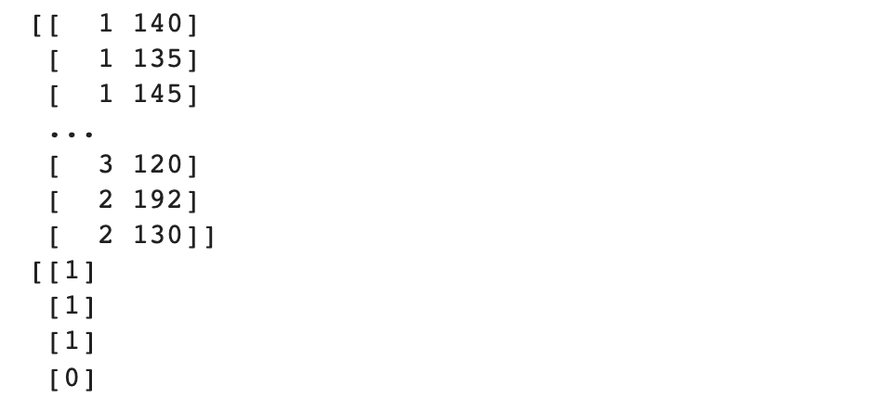
Partitioning the Data
X = heartdata.iloc[:, :1].values
y = heartdata.iloc[:, -1].values
#Split data into X and y
Train_X = np.array(heartdata.drop(['Age','Sex','HeartDisease'],1))
Train_y = np.array(heartdata[['HeartDisease']])
print(Train_X)
print(Train_y)

Slide 15

Predicting the Data
prediction = reg.predict(np.asarray([2,11]).reshape(1, -1))
print('Prediction:', prediction)

Slide 16
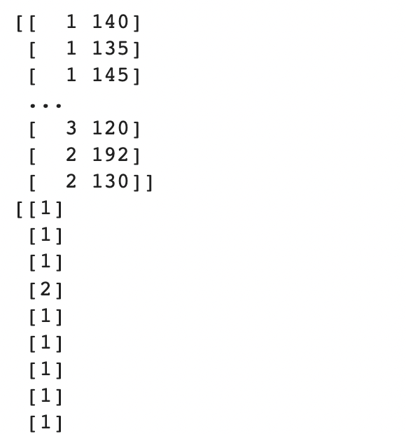
Partitioning Test Data
X = df.iloc[:, :1].values
y = df.iloc[:, -1].values
Test_X = np.array(df.drop(['Age','Sex','HeartDisease'],1))
Test_y = np.array(df[['HeartDisease']])
print(Test_X)
print(Test_y)

Slide 17

Predicting the Test Data
prediction2 = reg.predict(np.asarray([2,11]).reshape(1, -1))
print('Prediction:', prediction2)

Slide 18

Accuracy
from sklearn.metrics import mean_squared_error
mean_squared_error(Test_y_predicted, Test_y)

Slide 19
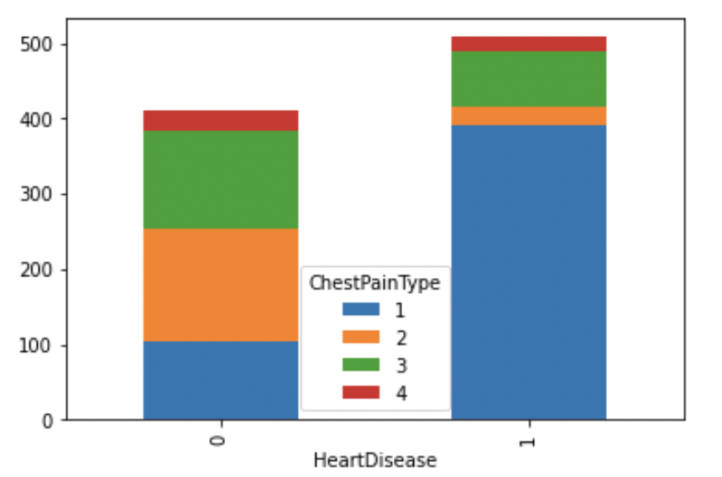
Bar Chart – Chest Pain and Heart Disease
#Stacked bar chart to show chest pain type with heart disease
heartdata.groupby(['HeartDisease', 'ChestPainType']).size().unstack().plot(kind='bar',stacked=True)
plt.show()

Slide 20
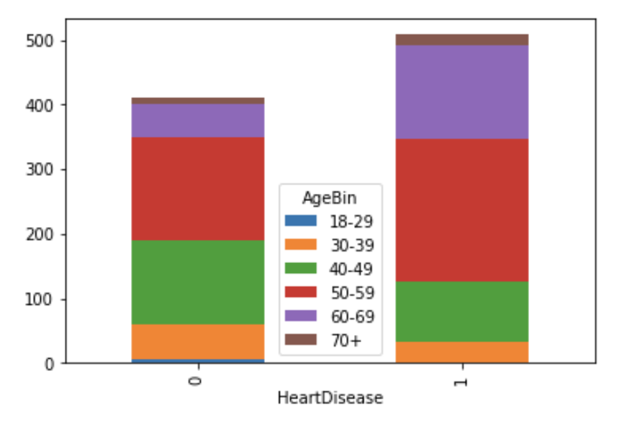
Bar Chart – Age by Heart Disease
#Stacked bar chart to show what age has more heart diseases
heartdata.groupby(["HeartDisease", Ages.AgeBin]).size().unstack().plot(kind='bar',stacked=True)
plt.show()

Slide 21
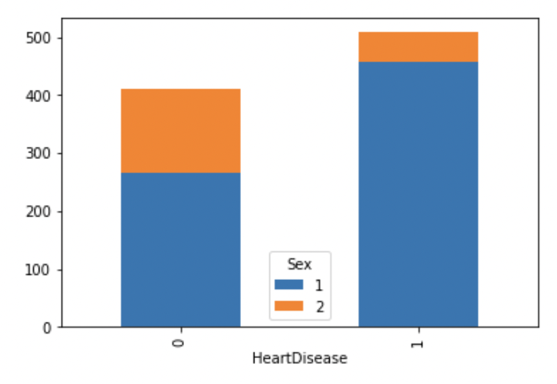
Bar Chart – Gender by Heart Disease
#Stacked bar chart to show which gender has more heart diseases
heartdata.groupby(["HeartDisease", 'Sex']).size().unstack().plot(kind='bar',stacked=True,)
plt.show()

Slide 22

Evaluation
The code is set up by these steps:
Cleaning the data
Changing the strings into numeric
Plot the relationships
Partition and predict the data and test data
Get the accuracy score

Slide 23

Conclusion
Patients with the ages 50-59 have an increased chance of developing heart disease.
These patients also have asymptomatic chest pain and Non-Anginal Pain.
Most of the patients with heart diseases are men.
Our accuracy was 1.163 which is pretty good

Slide 24

Recommendation
Objectives we met: We were able to structure the data to help us predict the likelihood of someone having heart disease.
Objectives we didn’t meet: With more in depth data, we would be able to create a program to allow patients and doctors to input their information and see the likelihood of them having heart disease.

Slide 25

Future Work
We believe that this program requires someone who is well versed in the medical field. However, we feel what we’ve done thus far shows future employers our python versatility.

